Slide 1
Using Logistic Regression to Predict the Presence of Kidney Stones
Anushka Limaye

Slide 2
Introduction
Kidney stone disease, or nephrolithiasis: hard deposits form in kidneys
15% of Americans experience kidney stones
50% of them are likely to get it again within the 10 years after the first time
Painful when passing through the ureter
Limited research done on the formation of the stones

Slide 3
Methods
Data: 79 urinary samples collected at Stanford School of Medicine
Gender, age, etc unknown
Parameters:
Specific gravity: density related to water
Urea: urea is nitrogen waste cleared by kidneys
Calcium
pH
Osmolarity
Conductivity
Target

Slide 4
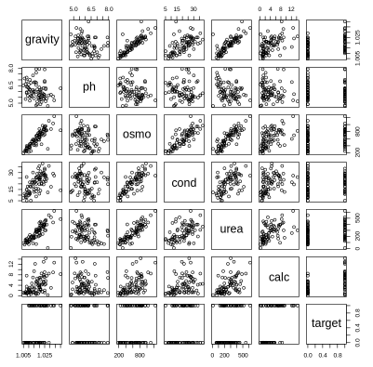
Methods
Linear Relationships
Gravity + Osmolarity
Gravity + Urea
Osmolarity + Urea
Osmolarity + Conductivity
Histograms

Slide 5
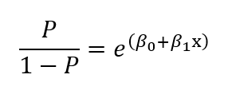
Methods- Logistic Regression
Outcome: Target → Binary
Finding the probability of the kidney stone presence (1) or lack of (0)
Odds Ratio: probability of presence/lack of
Taking the log of both sides results in logit equation → so a linear combination of the dependent variables
Notes:
Dependent variable binary

Slide 6
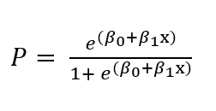
Methods- Logistic Regression
To fit the model: use equation to calculate the probability that a given observation takes on a value of 1
Apply a threshold to classify it as 1 or 0

Slide 7
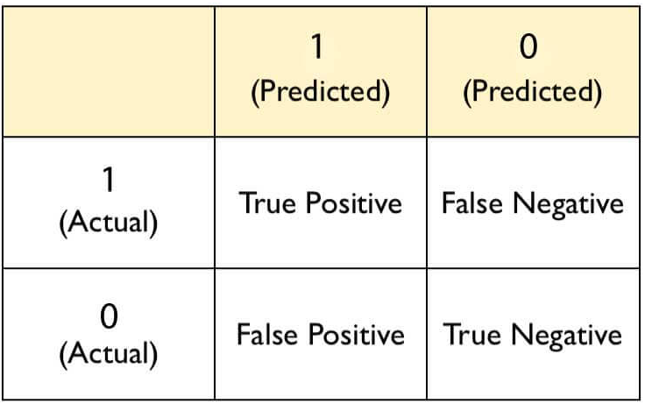
Methods: Training and Testing
Trained 16 multiple-regression models to determine significant parameters
Formed testing groups
Tested 6 groups to find the most influential parameters for prediction
AUC value of ROC curve (Receiver Operating Characteristic) to determine accuracy of predictions ~Area Under the Curve
Adjusted threshold values to optimize the accuracy

Slide 8
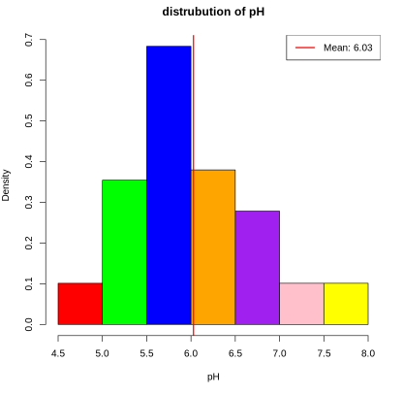
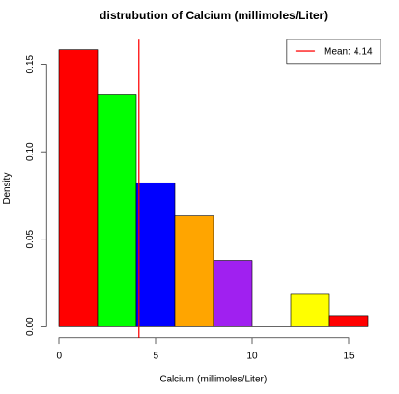
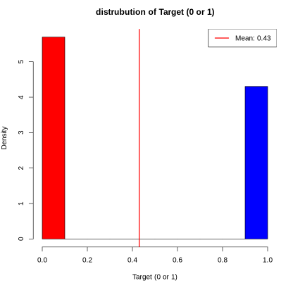
Results
Histograms EDA

Slide 9
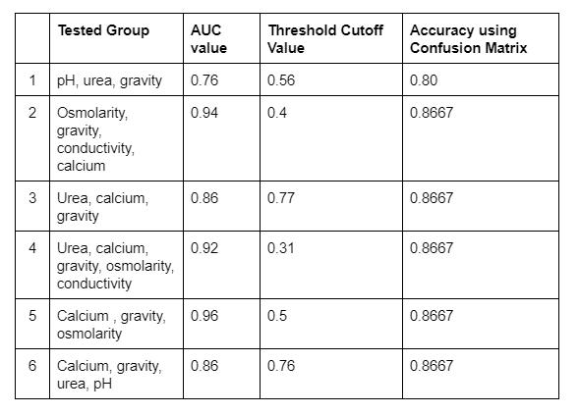
Table of Testing Groups Results
Group 1 is the least helpful predictors since the AUC value is so low
Group 5 is the most influential set of predictors due to the high 0.96 value
That means that the model predicted the presence of a kidney stone very well

Slide 10
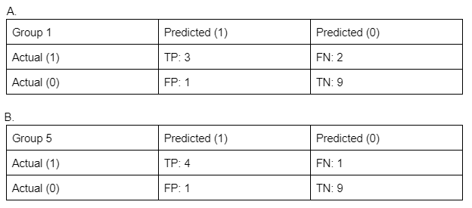
Confusion Matrices

Slide 11
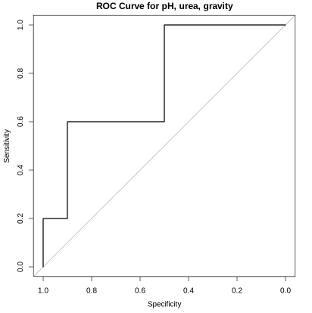
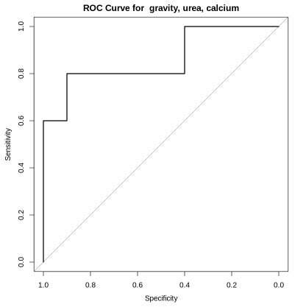
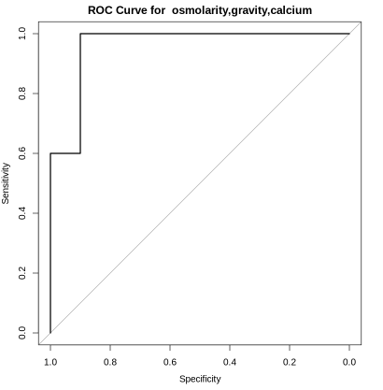
ROC Curves
The greater the AUC value, the less false positives. 0.5 would be random guessing

Slide 12
Conclusion
Calcium, specific gravity, and osmolarity are the most helpful predictors of kidney stones when analyzing urine samples
These findings can help urologists focus on more precise testing for these metrics and will be much more time and cost effective for patients
Limitations: no demographic data given
Such factors play such a large role in physiological data
They can help make more complex conclusions about specific groups of people, helping prognosis and treatment options
Future research: incorporating such parameters to deepen analysis

Slide 13
Thank You!

